Slide 1
Algorithms
Analysis of Algorithms - Part 4

Slide 2

Content
Analysis of Algorithms
Recurrence Relations
تحليل التكرار

Slide 3

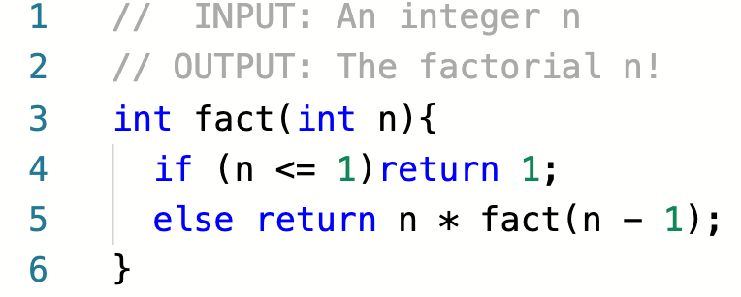
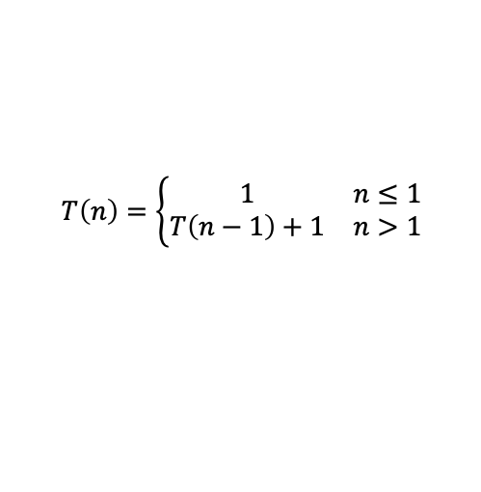
Recurrence Relations
What is a recurrence relation?
A recurrence is an equation that is used to represent the running time of a recursive algorithm
العلاقة التكرارية هي معادلة رياضية تستخدم لتمثل وقت الخوارزميات ذاتية الاستدعاء
$$T\left(n\right)=\left\{\begin{matrix}1 & n≤1 \\ T\left(n−1\right)+1 & n>1\end{matrix}\right.$$

Slide 4

Recurrence Relations
Cases of a Recurrence Relations
A recursive algorithm has two cases:
Base Case
Recursive Case
$$T\left(n\right)=\left\{\begin{matrix}1 & n≤1 \\ T\left(n−1\right)+1 & n>1\end{matrix}\right.$$

Slide 5

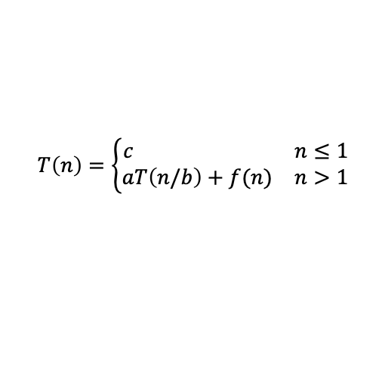
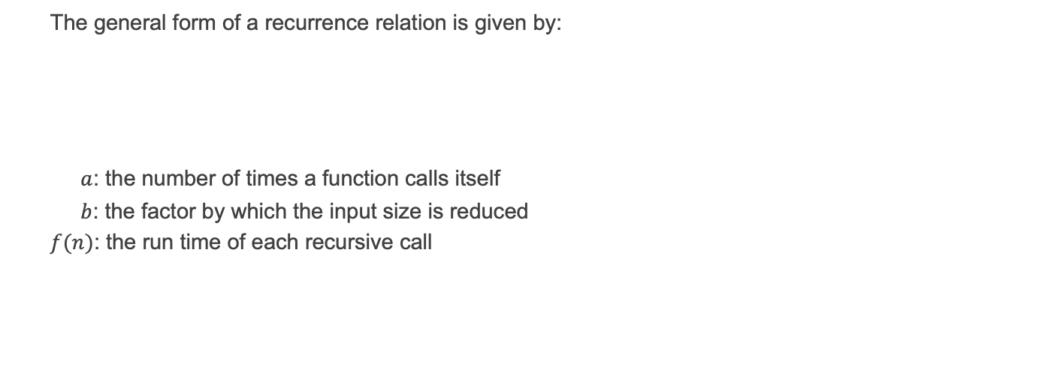
Recurrence Relations
General form of a Recurrence Relations
The general form of a recurrence relation is given by:
$a$: the number of times a function calls itself
$b$: the factor by which the input size is reduced
$f(n)$: the run time of each recursive call
$$T\left(n\right)=\left\{\begin{matrix}c & n≤1 \\ aT\left(n/b\right)+f(n) & n>1\end{matrix}\right.$$

Slide 6

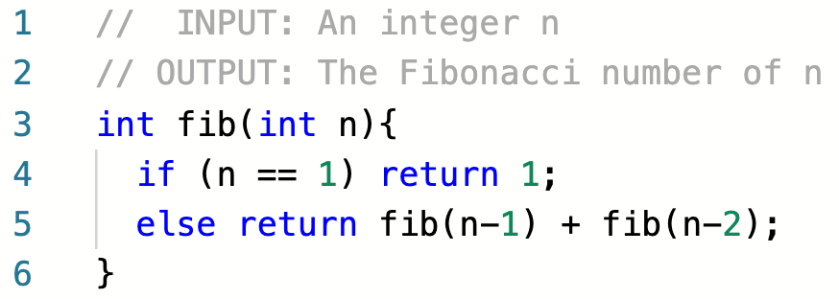
Recurrence Relations
Example 1
Derive the recurrence relation for the given algorithm

Slide 7
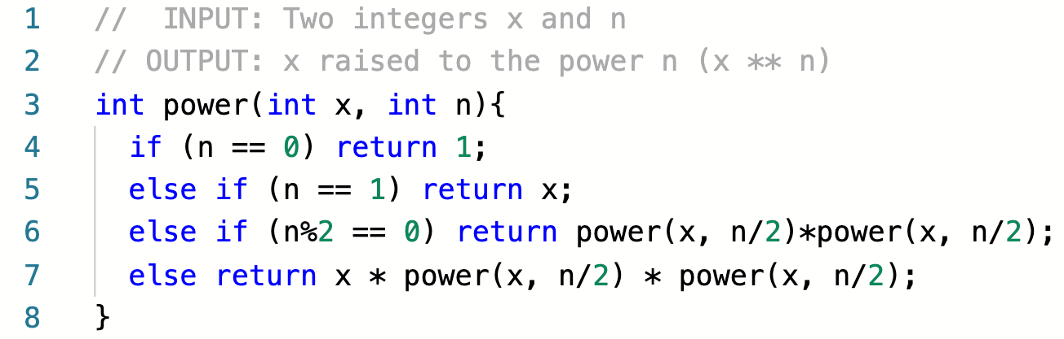
Recurrence Relations
Example 2
Derive the recurrence relation for the given algorithm

Slide 8

Recurrence Relations
Solving Recurrences
We will use 3 main methods for solving recurrences:
Iteration Method
Tree Method
Master Method

Slide 9
Iteration Method
Example 3: Solve $T\left(n\right)=T\left(n−1\right)+1,for n>1 and T\left(1\right)=1$

Slide 10

Iteration Method
LAB Exercise: Solve the following recurrence relations using WolframAlpha:
$$T\left(n\right)=T\left(n−1\right)+1,for n>1 and T\left(1\right)=1$$
https://www.wolframalpha.com/

Slide 11
Iteration Method
Example 4: Solve $T\left(n\right)=2T\left(\frac{n}{2}\right)+n,for n>1 and T\left(1\right)=1$

Slide 12

Iteration Method
LAB Exercise: Solve the following recurrence relations using WolframAlpha:
$$T\left(n\right)=2T\left(\frac{n}{2}\right)+n,for n>1 and T\left(1\right)=1$$
https://www.wolframalpha.com/

Slide 13
Tree Method
Example 5: Solve $T\left(n\right)=2T\left(\frac{n}{2}\right)+n,for n>1 and T\left(1\right)=5$

Slide 14

Tree Method
LAB Exercise: Solve the following recurrence relations using WolframAlpha:
$$T\left(n\right)=2T\left(\frac{n}{2}\right)+n,for n>1 and T\left(1\right)=5$$
https://www.wolframalpha.com/

Slide 15
Tree Method
Example 6: Solve $T\left(n\right)=2T\left(\frac{n}{2}\right)+n^{2},for n>1 and T\left(1\right)=5$

Slide 16

Tree Method
LAB Exercise: Solve the following recurrence relations using WolframAlpha:
$$T\left(n\right)=2T\left(\frac{n}{2}\right)+n^{2},for n>1 and T\left(1\right)=5$$
https://www.wolframalpha.com/

Slide 17
Tree Method
Example 7: Solve $T\left(n\right)=3T\left(\frac{n}{2}\right)+n^{2},for n>1 and T\left(1\right)=5$

Slide 18

Tree Method
LAB Exercise: Solve the following recurrence relations using WolframAlpha:
$$T\left(n\right)=3T\left(\frac{n}{2}\right)+n^{2},for n>1 and T\left(1\right)=5$$
https://www.wolframalpha.com/

Slide 19
Tree Method
Example 8: Solve $T\left(n\right)=T\left(\frac{n}{4}\right)+T\left(\frac{n}{2}\right)+n and T\left(1\right)=5$

Slide 20

Tree Method
LAB Exercise: Solve the following recurrence relations using WolframAlpha:
$$T\left(n\right)=T\left(\frac{n}{4}\right)+T\left(\frac{n}{2}\right)+n and T\left(1\right)=5$$
https://www.wolframalpha.com/

Slide 21
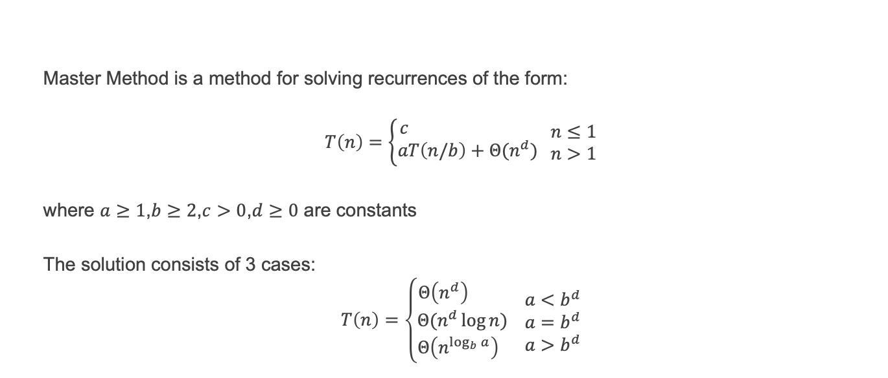
Master Method
Solving Recurrences Using Master Method
Master Method is a method for solving recurrences of the form:
$$T\left(n\right)=\left\{\begin{matrix}c \\ aT\left(n/b\right)+Θ(n^{d})\end{matrix}\begin{matrix} n≤1 \\ n>1\end{matrix}\right.$$
where $a≥1$,$b≥2$,$c>0$,$d≥0$ are constants
The solution consists of 3 cases:
$$T\left(n\right)=\left\{\begin{matrix}Θ\left(n^{d}\right) \\ Θ(n^{d}\log{n)} \\ Θ\left(n^{\log_{b}{a}}\right) \end{matrix}\begin{aligned} a<b^{d} \\ a=b^{d} \\ a>b^{d}\end{aligned}\right.$$

Slide 22
Master Method
Example 9: Solve $T\left(n\right)=2T\left(\frac{n}{2}\right)+n,for n>1 and T\left(1\right)=1$

Slide 23
Master Method
LAB Exercise: Solve the following recurrence relations using WolframAlpha:
$$T\left(n\right)=2T\left(\frac{n}{2}\right)+n,for n>1 and T\left(1\right)=1$$
https://www.wolframalpha.com/

Slide 24
Master Method
Example 10: Solve $T\left(n\right)=2T\left(\frac{n}{2}\right)+n^{2},for n>1 and T\left(1\right)=1$

Slide 25

Master Method
LAB Exercise: Solve the following recurrence relations using WolframAlpha:
$$T\left(n\right)=2T\left(\frac{n}{2}\right)+n^{2},for n>1 and T\left(1\right)=1$$
https://www.wolframalpha.com/

Slide 26
Master Method
Example 11: Solve $T\left(n\right)=9T\left(\frac{n}{3}\right)+n,for n>1 and T\left(1\right)=1$

Slide 27

Master Method
LAB Exercise: Solve the following recurrence relations using WolframAlpha:
$$T\left(n\right)=9T\left(\frac{n}{3}\right)+n,for n>1 and T\left(1\right)=1$$
https://www.wolframalpha.com/

Slide 28
Master Method
Example 12: Solve $T\left(n\right)=T\left(\frac{n}{2}\right)+1,for n>1 and T\left(1\right)=1$

Slide 29

Master Method
LAB Exercise: Solve the following recurrence relations using WolframAlpha:
$$T\left(n\right)=T\left(\frac{n}{2}\right)+1,for n>1 and T\left(1\right)=1$$
https://www.wolframalpha.com/

Slide 30
Master Method
Example 13: Solve $T\left(n\right)=4T\left(\frac{n}{2}\right)+n^{3},for n>1 and T\left(1\right)=1$

Slide 31

Master Method
LAB Exercise: Solve the following recurrence relations using WolframAlpha:
$$T\left(n\right)=4T\left(\frac{n}{2}\right)+n^{3},for n>1 and T\left(1\right)=1$$
https://www.wolframalpha.com/

Slide 32
Master Method
Example 14: Solve $T\left(n\right)=T\left(\frac{n}{2}\right)+n^{2},for n>1 and T\left(1\right)=1$

Slide 33

Master Method
LAB Exercise: Solve the following recurrence relations using WolframAlpha:
$$T\left(n\right)=T\left(\frac{n}{2}\right)+n^{2},for n>1 and T\left(1\right)=1$$
https://www.wolframalpha.com/

Slide 34
Master Method
Example 15: Solve $T\left(n\right)=4T\left(\frac{n}{2}\right)+n^{2},for n>1 and T\left(1\right)=1$

Slide 35

Master Method
LAB Exercise: Solve the following recurrence relations using WolframAlpha:
$$T\left(n\right)=4T\left(\frac{n}{2}\right)+n^{2},for n>1 and T\left(1\right)=1$$
https://www.wolframalpha.com/

Slide 36
Master Method
Example 16: Solve $T\left(n\right)=7T\left(\frac{n}{3}\right)+n^{2},for n>1 and T\left(1\right)=1$

Slide 37

Master Method
LAB Exercise: Solve the following recurrence relations using WolframAlpha:
$$T\left(n\right)=7T\left(\frac{n}{3}\right)+n^{2},for n>1 and T\left(1\right)=1$$
https://www.wolframalpha.com/

Slide 38
Master Method
Example 17: Solve $T\left(n\right)=7T\left(\frac{n}{2}\right)+n^{2},for n>1 and T\left(1\right)=1$

Slide 39

Master Method
LAB Exercise: Solve the following recurrence relations using WolframAlpha:
$$T\left(n\right)=7T\left(\frac{n}{2}\right)+n^{2},for n>1 and T\left(1\right)=1$$
https://www.wolframalpha.com/

Slide 40
Master Method
Example 18: Solve $T\left(n\right)=2T\left(\frac{n}{2}\right)+\sqrt{n},for n>1 and T\left(1\right)=1$

Slide 41

Master Method
LAB Exercise: Solve the following recurrence relations using WolframAlpha:
$$T\left(n\right)=2T\left(\frac{n}{2}\right)+\sqrt{n},for n>1 and T\left(1\right)=1$$
https://www.wolframalpha.com/

